Slide 1
Child Development Elementary School Age
PS 174 William Sidney Mount
April 10, 2019

Slide 2
Agenda/ Objectives
Development (Nature and Nurture)
-Early Brain Development
-Environment Development
Developmental Milestones
Milestones for Typical 4 year olds, Kindergarteners, 1st graders, 2nd graders, 3rd graders, 4th graders, & 5th graders milestones
Physical
Cognitive
Language/ Communication
Social and Emotional Learning
Notes:
Physical Domain:
body size, body proportions, appearance, brain development, motor development, perception capacities, physical health.
Cognitive Domain:
thought processes and intellectual abilities including attention, memory, problem solving, imagination, creativity, academic and everyday knowledge, metacognition, and language.
Social/Emotional Domain:
self-knowledge (self-esteem, metacognition, sexual identity, ethnic identity), moral reasoning, understanding and expression of emotions, self-regulation, temperament, understanding others, interpersonal skills, and friendships.

Slide 3
Early Brain Development (Nature)
Before the age of 5, it takes less time, intensity, and repetition to organize the developing neural systems than it does to reorganize already-developed neural systems
Significant adversity can produce physiological disruptions or biological “memories” that can undermine the development of the body’s stress response systems and affect the developing, brain, cardiovascular system, immune system and metabolic regulatory controls
Early events affects all aspects of a child’s development
First 1,000 days of life have a profound impact on brain development
Notes:
Born with a lifetime supply of neurons.
Genetics: Genetics supply a basic plan for brain development. It provides the structure for the brain’s architecture and supplies the means for interconnecting nerve cells within and across circuits.

Slide 4
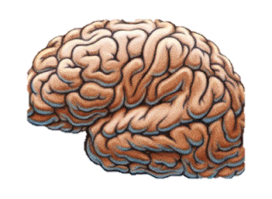
Newborn Brain Average Weight
333 grams/ .73 lbs
2 Year Old’s Brain Average Weight
999 grams/ 2.2 lbs

Slide 5
Environment Development (Nurture)
Children need places that are free from toxins and fears so that they can explore without significant risk of harm
Stable and responsive environments of relationships provide child with consistent, nurturing and protective interactions with adults that enhance their learning
Nurturing relationships in the early years are critical
Toxic stress has a negative impact on a child’s development
Notes:
Stable and responsive environments of relationships provide child with consistent, nurturing and protective interactions with adults that enhance their learning. This helps them develop adaptive capacities that promote well-regulated stress response. These positive relationships can serve as social/emotional buffers. With sufficient levels of social emotional buffering, the stress response can be either positive (and actually build resilience), or tolerable (and result in no sustained changes, positive or negative).
With insufficient levels of social-emotional buffering, the physiologic stress response is prolonged and becomes toxic, resulting in potentially permanent alterations to the epigenome, brain structure, and behavior.

Slide 6
Early Brain Development and Environment
This is not to say that if bad things happen there are necessarily long term negatives
Protective interventions such as:
Consistent supportive relationships with caring adults
Supportive environments, like high quality childcare and early intervention programs
Can serve as buffers and mitigate or lessen the effects of adverse childhood experience

Slide 7
Developmental Milestones
Developmental Milestones are a set of functional skills or age-specific tasks that most children can do at a certain age range
Professionals (Pediatricians, teachers, evaluators, child psychologists) use milestones to gage a child’s development
Although each milestone is different at each grade level, the actual age when a normally developing child reaches that milestone can vary quite a bit
Every child is unique!
Notes:
Different learning styles, different times we learn, and we grasp things differently. (right brain, left brain)

Slide 8
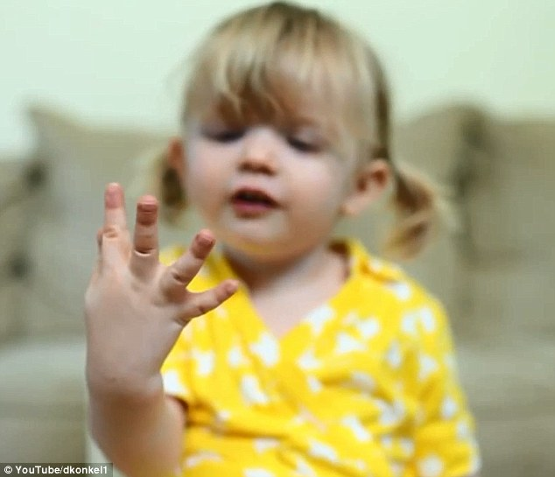
Milestones: 4 year old

Slide 9
Physical Milestone: 4 year old
Gross Motor Skills
Can skip, hop on one foot, catch and throw a ball overhand and walk downstairs alone
Control movement more easily; start, stop, turn and go around obstacles while running
Log roll, do somersaults, skip and trot
Get dressed with minimal help (zippers, snaps and buttons may still be a little hard)
Throw and bounce a ball
Pedal and steer a tricycle or bike
Fine Motor Skills
Draw or copy basic shapes and crosses (this is a milestone known as “being able to cross the midline”)
Write some letters
Begin to use scissors purposefully
Stack a tower at least 10 blocks high
String beads or O-shaped cereal to make necklaces
Pinch and shape clay or play-dough into recognizable objects

Slide 10
Cognitive Milestone: 4 year old
Understand the difference between real and make-believe
Understand that pictures and symbols stand for real things
Explore relationships between ideas, using words like if and when to express them
Start thinking in logical steps, which means seeing the “how-tos” and consequences of things
Get abstract ideas like “bigger,” “less,” “later,” “ago” and “soon”
Put things in order such as from biggest to smallest, shortest to tallest
Stick with an activity for 10 to 15 minutes
Notes:
This year, children’s ability to think and learn goes beyond the basics of the world around them. They start thinking about and understanding things they can’t see or touch; you might notice your child starts to become “an idea man.” Most children are developing skills to:

Slide 11
Language/ Communication Milestone: 4 year old
Sing silly songs, make up goofy words and start rhyming
Follow simple, unrelated directions (“Go find your shoes and pick up that toy.”)
Change speech patterns depending on who he’s having a conversation with, such as speaking in short sentences to a younger sibling
Pronounce most sounds correctly, but still have trouble with s, w and r sounds
Ask for the definition of unfamiliar words
Make up stories and talk about what he’s thinking
Argue, even though the argument might not be logical
Notes:
Language development tends to explode this year. This may include developing a vocabulary of more than 1,000 words and using complicated sentences that combine more than one thought. Kids start asking who, what, why, when and where questions—and maybe even can answer some too. By the end of this year, most children can do these things:

Slide 12
Social & Emotional Milestone: 4 year old
Begin to become less aware of only one’s self and more aware of people around them
May obey parent’s rules but don’t understand right from wrong
Are very independent and want to do things on their own
May have imaginary playmates and will often play with others in groups
Share, cooperate, be helpful and take turns
Start acting a little bossy and start tattling
Notes:
Enjoy telling silly jokes and find other things funny
Begin telling small lies to get out of trouble, even though he knows it’s wrong
Do or say things he shouldn’t to see what the reaction will be
Have imaginary friends and play the same imaginary games over and over

Slide 13
Milestones: Kindergarteners

Slide 14
Physical Milestone: Kindergarteners
Gross Motor Skills
Walk on tiptoes and heel-to-toe like on a balance beam
Jump rope and pump legs to swing alone
Stand and hop on each foot
Catch a ball the size of a softball
Start to move in different ways at the same time to do things like swim, dribble a basketball or dance
Fine Motor Skills
Use one hand more than the other (known as “hand dominance”)
Hold a pencil using a tripod grip (two fingers and a thumb)
Cut out basic shapes with scissors; may be able to cut a straight line
Use a fork, spoon and knife easily
Be able to wipe and wash after using the bathroom
Notes:
Kids tend to be fairly active at this age and can run, hop, skip and jump without tripping over their own feet. Most 5-year-olds learn to do these things:

Slide 15
Cognitive Milestones: Kindergarteners
Recognize and name colors and basic shapes
Know the letters of the alphabet and letter sounds
Recite their name, address and phone number
Understand basic concepts about print (such as knowing which way the pages go and how words are read left to right and top to bottom)
Know that stories have a beginning, middle, and end
Count groups of objects up to 10 and recite numbers to 20
Stick with an activity for 15 minutes and finish a short project
Make plans about how to play, what to build or what to draw
Notes:
Kindergartners learn facts and begin to grasp some basic concepts. By the end of kindergarten, many children can do things like these:

Slide 16
Language/ Communication: Kindergarteners
Use words to argue and try to reason with people; because is an oft-used word
Use most plurals, pronouns and tenses correctly
Tell stories, jokes and riddles; may understand simple puns
Use language to talk about opposites and compare things (“That black cat is smaller than the white one.”)
Talk about things that are going to happen as well as things that have already happened
Follow simple multi-step directions
Notes:
In kindergarten, most kids understand and can use thousands of words, usually in sentences five to eight words long. Many 5-year-olds have the language development needed to:
By the end of kindergarten, most children can recognize common words, such as the and me, and they can begin reading three-letter words, like hat.

Slide 17
Social & Emotional Milestones: Kindergarteners
Have an interest in behaving like their friends and wanting their approval
Begin to prefer same-gender friendships; become jealous of other people spending time with “their” friends
Follow the rules most of the time; may criticize kids who don’t follow the rules
Enjoy being on display; will sing, dance or be silly to get attention
Want your approval and to be taken seriously; may throw a tantrum or get angry if they thinks they’re not being listened to
Start to see why it’s helpful to share and get along with other kids
Notes:
During the kindergarten school year, children’s social and emotional development tends to go beyond making friends and expressing feelings. They start understanding more complicated things like right and wrong. Many 5-year-olds are also likely to do these

Slide 18
Video on Kindergartners on Writing Skills
https://www.understood.org/en/learning-attention-issues/signs-symptoms/age-by-age-learning-skills/video-what-kindergarten-writing-looks-like
https://www.youtube.com/watch?v=V0qXp7KH0eE

Slide 19
Milestones: 1st graders

Slide 20
Physical Milestones: 1st graders
Have stamina and coordination
Have improved hand-eye coordination for things like kicking a ball or tying shoelaces
Dance in time with the music, perhaps even adding cool moves like spinning in place without moving from one spot
Have improved handwriting that becomes neater and easier to read
Notes:
Most children gain stamina and coordination during first grade. They typically start the year uncoordinated and clumsy, because the big muscles in arms and legs are better developed than the small muscles used for smaller movements. What they can do physically doesn’t change as much as how well they’re able to do it. Most children reach these milestones in first grade:

Slide 21
Cognitive Milestones: 1st graders
Start developing the skills to reason and think logically; try to think about things before making decisions
Use what they hear and read to start learning—not just what they see and do
Find it hard to make choices because they want to do everything at once
Can read a number of sight words (words they see frequently and can read without sounding out) and sound out and read other words
Begin to have a better sense of time; understand increments of time, days, weeks, months and seasons
Notes:
Your child’s thinking skills in first grade allow him to start exploring the world to find answers to his own questions.

Slide 22
Language/Communication Milestones: 1st graders
Use language in long and complicated sentences to tell about past, present and future.
Start combining spoken language with reading and writing this year
Start sounding out words; understand the relationship between letters and sounds
Know, use and understand thousands of words
Stop reversing letters (by the end of first grade)
Notes:
Your child’s thinking skills in first grade allow him to start exploring the world to find answers to his own questions.

Slide 23
Social & Emotional Milestones: 1st graders
Are more independent, but less secure; want a lot of attention and approval from adults
Form and break friendships easily; can be critical of other kids
Have feelings hurt more easily and start being very aware of other people’s feelings
Are eager to please and want to “be first” and win
Understand right from wrong, but look for the loopholes in rules to get what they want
Become more gracious losers and are able to reflect on their role in conflicts (by the end of the year)
Notes:
First-grade social and emotional skills are an interesting mix of independence and an increased need for your attention and approval. By age 7, kids typically start to understand that friendships aren’t something they can control by themselves. That may make them a little anxious.

Slide 24
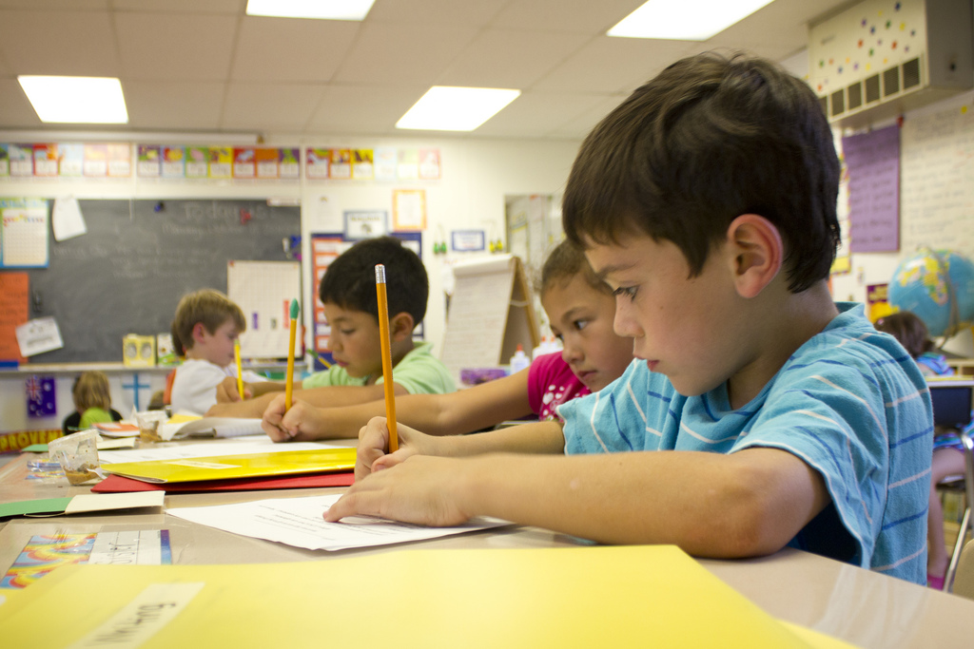
Milestones: 2nd graders

Slide 25
Physical Milestones: 2nd graders
Gain strength in both big and small muscles; can play and be active for longer periods without getting tired
Use the small muscles in hands better; do much better with handwriting, scissor skills and manipulating things like buttons, zippers and shoelaces
Start being able to run farther and for longer

Slide 26
Cognitive Milestones: 2nd graders
Look for the reasons behind things; ask questions for more information
Understand cause and effect and make more in-depth connections (for example, know things like if 6 + 2 = 8, then 8 ‒ 6 = 2)
Start planning ahead; may create a drawing of something to build or a plan for an experiment
Have a longer attention span; can sit and pay attention to something that interests them for at least 30–45 minutes
Collect things
Notes:
At this age, thinking and problem-solving skills are taking off. Children tend to talk at a more adult level and start to show an interest in specific activities that interest them. Cognitively, most children at this age:

Slide 27
Language/ Communication Milestones: 2nd graders
Comprehend what they’re reading and begin to move from “learning to read” to “reading to learn”
Learn vocabulary through reading
Use words to talk through problems, both socially and academically
Start playing with words to make puns; understand jokes and riddles
Test out “bad” words for shock value
Use all letter sounds correctly; don’t substitute w for r anymore when speaking
Use writing as a way to express feelings, tell stories and summarize information
Notes:
Language development typically continues at a steady pace these two years. Vocabulary grows and kids start trying out words they have read but not heard. By the end of third grade, most children can do these things:

Slide 28
Social & Emotional Milestones: 2nd graders
Have moments of extreme insecurity and need a lot of encouragement from parents
Change often between being helpful and upbeat to being rude and selfish
Enjoy being part of a team, group or club
Spend more time with and be easily influenced by peers
Experience periods of dramatic emotion and impatience and the feeling that everyone is against them and then bounce right back to everything being just fine
Start seeing things from other points of view and incorporate that into everyday life
Notes:
Second and third grade can be a little rough socially and emotionally. Kids start narrowing down to a few good friends, but those friendships can change quickly. Most kids are eager to fit in and try out new personalities to see where they fit. By the end of third grade, most children will:

Slide 29
2nd graders Video Writing
https://www.understood.org/en/learning-attention-issues/signs-symptoms/age-by-age-learning-skills/video-what-second-grade-writing-looks-like
https://www.youtube.com/watch?v=HmSpzWSYsnE

Slide 30
Milestones: 3rd graders

Slide 31
Physical Milestones: 3rd graders
Usually full of energy for a short burst, and then tire easily
Having improving hand-eye coordination and fine motor skills
Can focus on things near and far
Developing greater coordination, muscle strength, balance, stigma
Ability to run, jump, kick and catch a ball greatly improves

Slide 32
Cognitive Milestones: 3rd graders
Will start to organize and sort assignments, objects
Usually care about process and product; eager for approval of adults
Increasing interested in logic, classification, and how things work
Can discuss topic in a deeper level, can clarify information
Can now start to predict events that may happen
Grasp the understanding of algebra, how to calculate money, measure, length, graphs and lines

Slide 33
Language/ Communication Milestone: 3rd graders
Vocabulary is growing quickly, love to talk and share ideas
Tend to exaggerate
Tend to listen well, but have to many ideas that they may not remember what they heard

Slide 34
Social & Emotional Milestones: 3rd graders
Enjoy working and socializing in groups
Adjust well to change
Enjoy larger friendship groups, preferably with same gender friends
Willing to take risks; usually recover quickly from mistakes and problems
Concerned with fairness and justice; often argues and complains about fairness issues

Slide 35
Milestones: 4th graders

Slide 36
Physical Milestone: 4th graders
Have an increased appetite and need more sleep
Use one hand and foot much better than the other (“Right/left dominance” starts at around age 7 and is set around fourth or fifth grade.)
Show improvement in handwriting and the ability to use tools

Slide 37
Cognitive Milestone: 4th graders
Realize that thoughts are private and that people see others differently than they see themselves
Start predicting the consequences of an action
Can argue more than just one side of an issue (Discover ways to help your child learn to self-advocate, not just argue.)
Use of social media starts really developing

Slide 38
Social & Emotional Milestones: 4th graders
Have a first crush or pretend to have crushes to fit in with peers
Test limits; try to figure out which rules are negotiable and which are not
Are increasingly independent from family and have a growing interest in their friends

Slide 39
4th grade Video Writing
https://www.understood.org/en/learning-attention-issues/signs-symptoms/age-by-age-learning-skills/video-what-fourth-grade-writing-looks-like
https://www.youtube.com/watch?v=cS0R0n_D_vI

Slide 40
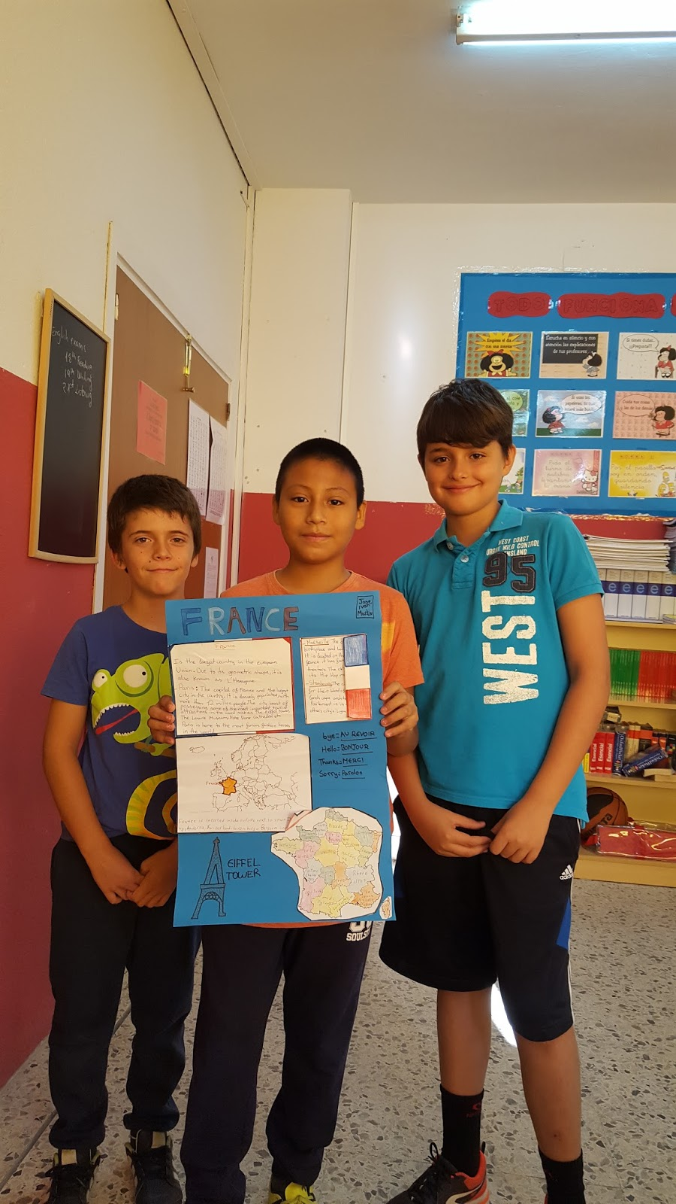
Milestones: 5th graders

Slide 41
Physical Milestone: 5th graders
Have an increased appetite and need more sleep
Develop hand-eye coordination quickly (This also may be when you notice your child’s need for glasses.)
Complain of growing pains or muscle cramps
Start showing signs of puberty such as hair growth or oily skin; girls may have weight gain or redistribution and boys’ voices may start to change
Notes:
Fourth and fifth grade can be years of change in many ways. Typical developmental milestones at these ages often revolve around a child’s changing body, the need for independence and a desire to be accepted by peers.
Your child’s body is working hard as puberty approaches. Most boys and girls grow steadily, only to speed up by age 11 or 12. Girls and boys start developing at different rates. Girls tend to have their growth spurt between ages 9 and 11, while boys have theirs between ages 11 and 12. Most kids in fourth and fifth grade:

Slide 42
Cognitive Milestone: 5th graders
Begin to use social media, friends and the news to get information and form opinions
Develop a better sense of responsibility; look out for younger siblings and help out around the house
Start understanding how things are connected; are able to understand the effects of climate change, for example, or how the behavior or mood of one person in the house can impact everyone else
Notes:
Kids this age typically start being able to think more about abstract ideasand not just about things they can observe. The ability to organize thoughts and to plan improves, too. However, it’s still hard for your child to sort facts from opinions. Most kids:

Slide 43
Social & Emotional Milestones: 5th graders
Are uncertain about puberty and changes to their bodies
Are insecure or have mood swings and struggle with self-esteem (This tends to be more pronounced in girls.)
Test limits; try to figure out which rules are negotiable and which are not
Form stronger and more complex friendships. May face strong peer pressure and find it hard to resist if they struggle with self-esteem
Have a deeper understanding of how relationships with others can include more than just common interests

Slide 44
5th grade Video Writing
https://www.understood.org/en/learning-attention-issues/signs-symptoms/age-by-age-learning-skills/video-what-fifth-grade-writing-looks-like
https://www.youtube.com/watch?v=T0WUw4xNEwQ

Slide 45
Questions? Thank you!

